Slide 1
Descriptive Image Captioning using Vision and Language Models
Christian Martin, Awais Naeem

Slide 2
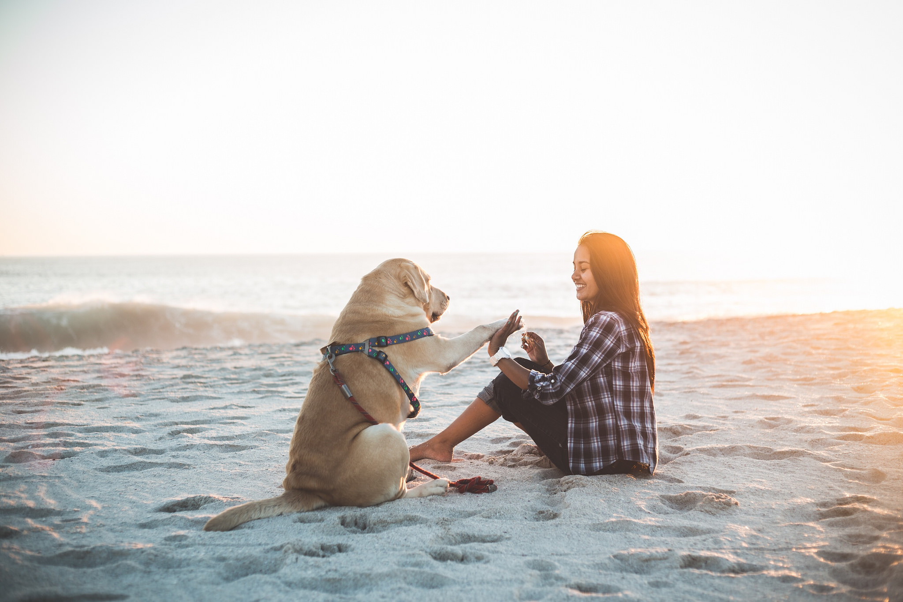
Problem Statement
Image captions are useful for a variety of reasons
Captioning user-uploaded images on social media
Enhancing product listings on e-commerce sites
Generating descriptions of X-ray images to assist radiologists
Captioning images on travel, real estate and education websites to drive business growth
Alt text of images for accessibility needs
Reverse Image search on Google and image hosting sites
Current state-of-art models generate short (non-descriptive) captions:
Salesforce/blip-image-captioning-base
"a woman sitting on the beach with her dog" (41 chars)

Slide 3
Problem Statement/Resolution
A descriptive caption will make more sense:
How to generate descriptive captions 2-4 times longer than state-of-the-art?
Dataset containing Image-Caption pairs with descriptive captions
Fine-Tuning an Image Captioning LLM
Generate synthetic data using pre-trained vision and language models
Fine-Tuning a text generative LLM
"a smiling woman is enjoying her time on the beach with her dog with the sea waves originating by their side. The golden colored dog has a colorful strap on and seems to be playing within the company of the girl."

Slide 4
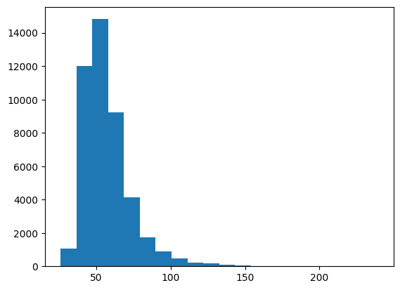
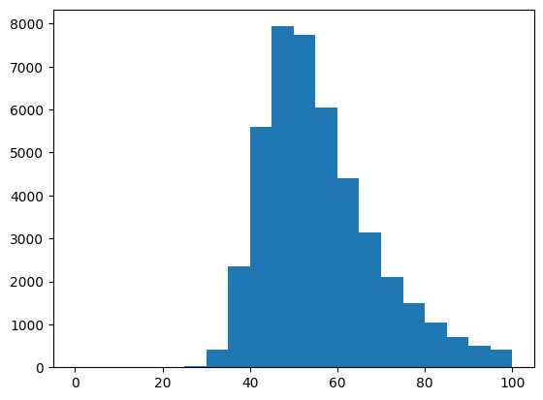
Current Status Quo
To estimate the caption length of the BLIP model, we looked at the nocaps dataset that was one of the two datasets used in training BLIP. The captions in nocaps are typically 45-70 characters long, with almost all being about 30-100 characters. We chose to aim for about 2-4x the length of these captions.
Lengths of captions in nocaps, in characters:

Slide 5
Dataset
The Cooper Hewitt (part of the Smithsonian) has created Guidelines for Image Description
The Smithsonian releases almost all of its metadata as part of its Open Access program
Problem: Cooper Hewitt has ~40k records and ~760GB of high-res images
We can filter the metadata to find records with both a long description and a CC0 JPEG image
This made to a filtered set of ~20k records and ~220GB images
Images were downloaded and downsized, reducing the size to about ~2.4GB
We also built a custom downloader using the boto3 and multiprocessing libraries to only download the portion of the images we were using.

Slide 6
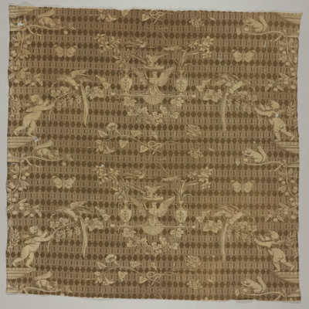
Methods
Fine-Tuning Image Captioning LLM (Direct Approach)
Fine-tuned on custom Image-Text Pairs
blip-image-captioning-base
contrastive learning/prediction
Long Caption
short-captions -> long-captions
LLM Text Generation using Visual/Language Models (Indirect Approach)
object-detector
learning/prediction on
<object_list, short_caption, long_captions
<object_list, short_caption>
text generator
Long Caption
Caption-generator

Slide 7
Fine-Tuning Image Captioning LLM
One of the major challenges faced was not having memory available to train the model. During training, the Trainer would be terminated for running out of memory. We did not have an exact number of how much memory was needed, but the estimate for the original approach was ~40GB, which would be about the largest paid GPU that Google Colab will allow.
Here are the methods we attempted to address this:
Using CPU (rather than GPU) for training, with load_in_8bit and Intel's IPEX (AVX2) hardware acceleration
Using PEFT+LoRA to reduce how much of the model was being changed during training
Disabling evaluation in the Trainer (reduces the memory needed about 2-3x)

Slide 8
Fine-Tuning Challenges
Selective downloading parts of datasets is awkward
Learned Python multiprocessing and AWS boto libraries (along with using a healthy dose of CLI tools)
Models for fine-tuning are large
BLIP appears to require ~40GB, possibly more, of RAM/VRAM to train
Personal & Colab T4 GPUs maxed out
Attempted to train on CPU using IPEX (Intel AVX) acceleration
Est. 48hrs to train for 5 epochs
Killed by OOM Daemon a few hours in

Slide 9
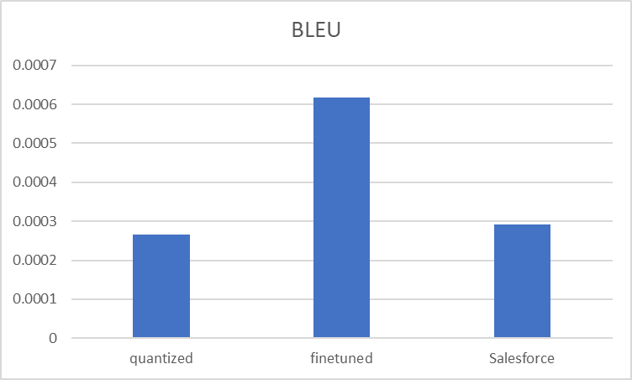
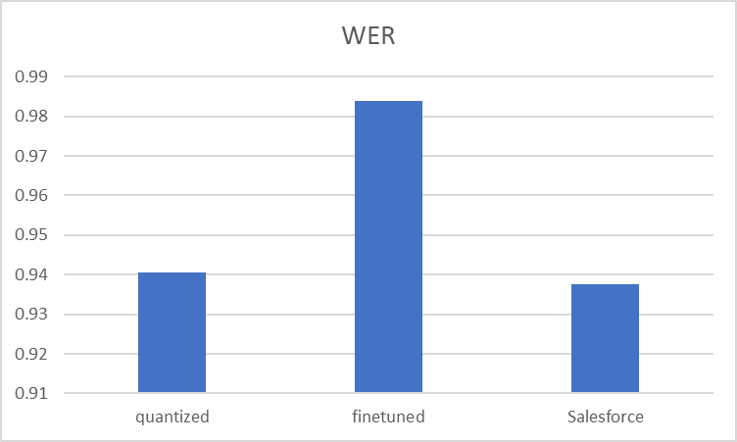
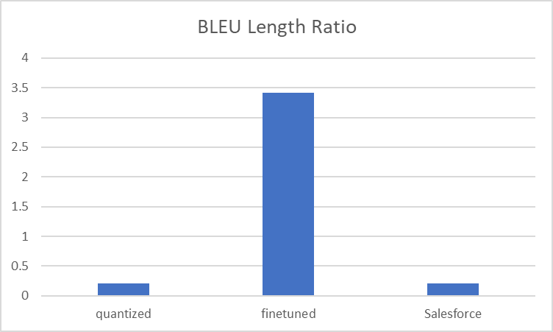
Fine-Tuning Results
Used Hugging Face libraries to perform optimized fine-tuning using int8 PEFT+LoRA
So, how did we do? BLEU and WER were much higher, and the BLEU length ratio was also high

Slide 10
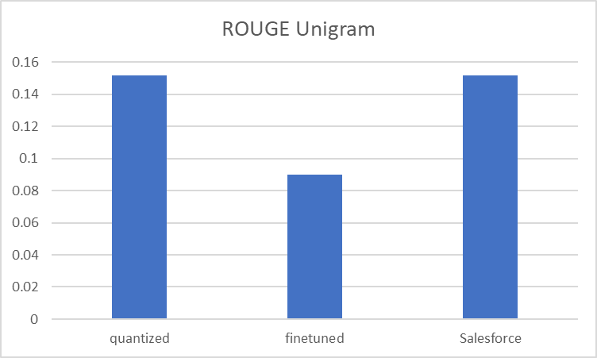
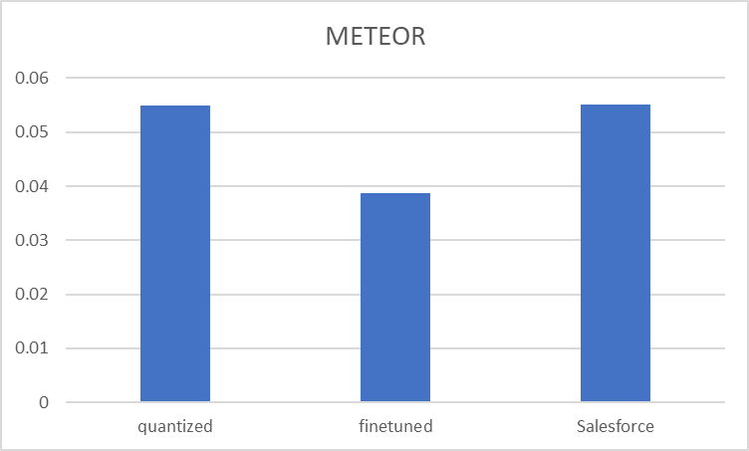
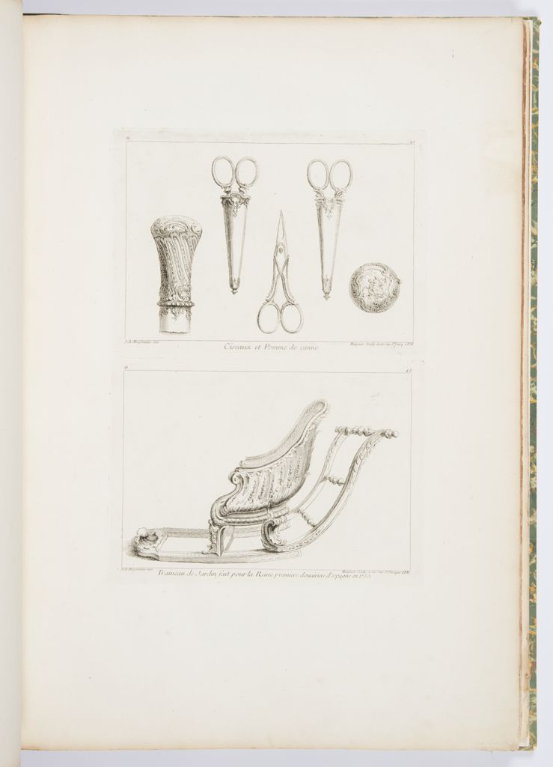
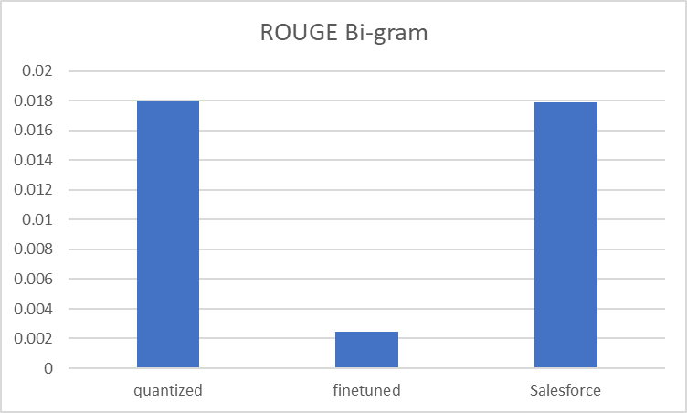
But that's not the full story
Other metrics were much worse
And the text generated was essentially junk
a and a - in a - large, large, large, large, large, large, large, large, large, large, large, large, large, large, large, large, large, large, multi, multi, natural, la, la, la, la, la, la, la, la, the, la, the, the, la, la, the, the, the, the, the, the, the, the, the, the, the,
a - - -, blue, blue, blue, and, blue, blue, blue, blue,,,,,,,,,,,,,,,,,,,,,,,,,,,,,,,,,,,,,,,,,,,,,,,,,,,,,,,,,,,,,,,,,,,,,,,,,,,,,,,,,,,,,,,,,,,,,,,,,,,,,,,,,,,,,,,,,,,,,,,,,,,, ',,, ','''''''''''''''''''''''''''''''''''''''''''''''' '
Also, inference was about 10x slower

Slide 11
Is the model overfitting undesirably?
Method
Generated Description
Train & Evaluate on a small number of records
Removed stop words and commas to remove most commonly repeated outputs
Changed metric to ROUGE
Model quickly outputs greater length; however, the quality of the output does not improve.
Experiment yielded a 0 on BLEU and ROUGE bigrams, along with close to 0 on ROUGE unigrams
a, book bottom bottom bottom bottom bottom bottom bottom bottom bottom wall wall wall wall wall wall wall wall wall wall wall wall wall wall wall person person person person person person person person person person person person person person person person person person person person person person person person person person person person person person person person person person person person person person person person person person person person person personrarararararararararararararararararararararararararararararararararararararararararararara

Slide 12
LLM Text Generation using Vision and Language Model
object-detector
learning/prediction on
<object_list, short_caption, long_captions
<object_list, short_caption>
text generator
Long Caption
Caption-generator
Object Detector (Vision Model):
Retinanet Resnet 50 FPN
Caption Generator (Language Model):
BLIP Image Captioning Base
Text Generator (Language Model)
Facebook BART Large CNN

Slide 13
LLM Text Generation Training/Fine-tuning
Long Caption: Landscape with two horsemen enter the composition from the left foreground, one with a falcon standing on his left hand. Falcons hunt birds in the background. Framing line at the bottom.
Object List: ['enter', 'bird', 'bottom', 'composition', 'framing', 'falcon', 'hand', 'one', 'background', 'foreground', 'left', 'line', 'standing', 'hunt', 'two', 'landscape', 'horseman']
Short Caption: Two horsemen, falcon, hunting birds, framed line at bottom.
LLM Prompt: objects: enter, bird, bottom, composition, framing, falcon, hand, one, background, foreground, left, line, standing, hunt, two, landscape, horseman; caption: Two horsemen, falcon, hunting birds, framed line at bottom.
Tokenization, Stop word,
Punctuation,
Lemmatization,
Unique words
Dataset
object_list
Long
Caption
facebook/bart-large-cnn
fine-tuning on
<object_list, short_caption, long_captions
<object_list, short_caption>
Fine-Tuned on 2000 training examples
Validation Data contains 100 test samples
short_caption
OpenAI API
messages=[
{"role": "system", "content": "You are a text summarization assistant, skilled in summarizing long image captions to short captions"},
{"role": "user", "content": "Summarize the following caption to only 10 words: " + long_caption
}]

Slide 14
LLM Text Generation Prediction/Run-Time
retinanet_resnet50_fpn
object_list
prediction using
<object_list, short_caption>
<object_list, short_caption>
facebook/bart-large-cnn
Long Caption
short_caption
blip-image-captioning-base
Object List: ['cat', 'laptop', 'chair', 'train', 'sink', 'suitcase', 'bed', 'bench', 'couch', 'person', 'boat', 'tv', 'potted plant', 'dining table']
Short Caption: textile fragment with floral design
LLM Prompt: objects: cat, laptop, chair, train, sink, suitcase, bed, bench, couch, person, boat, tv, potted plant, dining table; caption: textile fragment with floral design
Predicted Long Caption: Textile fragment with a potted plant, couch, chair, sofa, bed, laptop, chair and suitcase. In the sink are people on boats, in the living room a couch, on the dining table a chair, on a bench, a couch and chair, and on the sofa are a cat, a bed, and a suitcase.

Slide 15
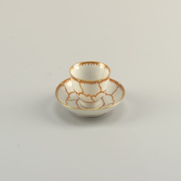
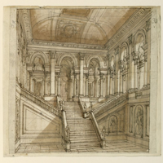
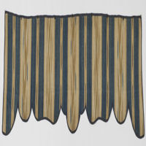
LLM Text Generation Prediction Examples
Actual Caption: Decorated in red and gold, in outline of conventionalized petals. In center of saucer and inside tea bowl is a butterfly.
Predicted Caption: Small cup and saucer on dining table. Vase, wine glass, vase, bowl, spoon, and bottle of wine. Sandwich on top of cup. Cake in cup and on saucer with a spoon and a vase at the bottom of the bottle.
Actual Caption: Horizontal rectangle. Staircase in palace with portico at top of stairs. Some details in graphite only, possibly unfinished.
Predicted Caption: Drawing of a staircase in a building. Traffic light, bench, and potted plant. In the drawing, a person is on a road light, and a building has a staircase with a bench and traffic light above it, with a building with a person on it.
Actual Caption: Wide valance with bands of solid blue and ochre, pink and beige weft ikat. Same fabric used as part of the facing on the back of the valance. valance is bound with plain weave tape.
Predicted Caption: Blue and brown curtain with a white background. Kitchen bench, dining table, sink, refrigerator, freezer, toaster, coffee table, bed, bedside table, sofa, chair, laptop, coffee cup, fork, knife, suitcase, toothbrush, umbrella, vase, frisbee, cat, pizza, cake, books, toys, surfboard, car, boat, train, and elephant. Stop sign with person and cat tied to it.

Slide 16
LLM Text Generation Limitations
Resource Intensive Training
Storage issue due to image dataset (almost 3000 for test, 18000 for training data)
RAM Issue because of loading multiple models i.e., blip-image-captioning-base, retinanet-resnet50-fpn, bart-large-cnn
Slow response times from OpenAI to get the short captions for training
Less number of Samples
Only 2000 samples for training because of OpenAI response time
Only 100 test samples because of the limited RAM

Slide 17
LLM Text Generation Results (100 Test Samples)
Rouge1:
Low -> Precision = 0.12, Recall = 0.12, f-measure=0.13
Mid -> Precision = 0.13, Recall = 0.18, f-measure=0.15
High -> Precision = 0.15, Recall = 0.19, f-measure=0.16
Rouge2:
Low -> Precision = 0.009, Recall = 0.011, f-measure=0.010
Mid -> Precision = 0.012, Recall = 0.016, f-measure=0.013
High -> Precision = 0.016, Recall = 0.021, f-measure=0.017
RougeL:
Low -> Precision = 0.098, Recall = 0.132, f-measure=0.109
Mid -> Precision = 0.108, Recall = 0.144, f-measure=0.118
High -> Precision = 0.117, Recall = 0.154, f-measure=0.126

Slide 18
LLM Text Generation Results (100 Test Samples)
Similarity Measures (Between Actual and Predicted Long Captions):
BERT Base Uncased: 0.7098
Word2Vec: 0.6026
Caption Word Lengths (Average):
Actual: 35.84
Predicted: 51.38
State-of-the-Art (blip-image-captioning-base): 10

Slide 19
Conclusions / Future Work
Fine-tuning the image captioning model on descriptive captions generates RANDOM text:
PEFT Training
Shrinking the model weight values to 8-bit
Improvement: A high resource GPU to fine-tune the model without PEFT
LLM Text generation model generates long captions, but random words appear which are not representative of the image itself:
Training on low number of training samples (2000)
Synthetic object list generated after processing text is limited in extracting the objects
Improvement: Training on complete set of training samples (18000) on resource intensive GPU

Slide 20

Question/Answers

